Slide 1
South to North Bengaluru
Identifying similar neighbourhoods

Slide 2
Grouping Bengaluru neighbourhoods
Bengaluru is a large multi-cultural city that is ever expanding with a huge working population
Proximity to office and other amenities like restaurants, pubs, parks, etc. are important factors when it comes to identifying the perfect neighbourhood for:
Working class members moving from one part of the country to another
Small business owners who want to expand by setting up outlets is other parts of the city
Real estate investors
HSR Layout is a popular neighbourhood in South Bengaluru that is considered to be a specific case for deep dive

Slide 3
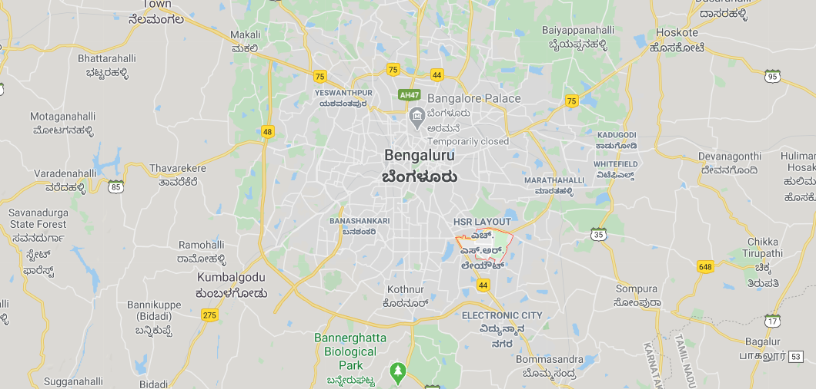
Visualization of Bengaluru city

Slide 4
Data acquisition and cleaning
Details of Bengaluru neighbourhoods and their rental rates are obtained from Makaan.com
2BHKs rates are considered for analysis
Geographical coordinates of the nrighbourhoods are fetched using Geocoder
The cleaned dataset consists of 340 neighbourhoods
Details of 150 popular venues within a 1.75km radius are fetched for each neighbourhood using Foursquare API including
Venue coordinates
Venue categories

Slide 5
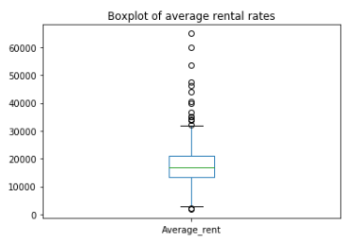
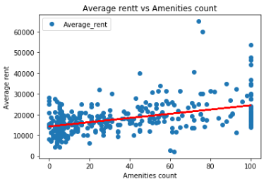
Average rental rates trends
Mean rental rate – Rs. 18000
Standard deviation – Rs. 7800
50% of neighbourhoods within Rs. 13500-21000
HSR Layout in 4th quartile – Rs. 26750 on higher end of the spectrum
Several outliers corresponding to affluent, posh neighbourhoods
Linear relationship between number of amenities an rental rates

Slide 6
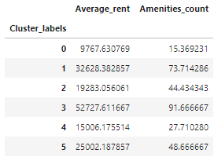

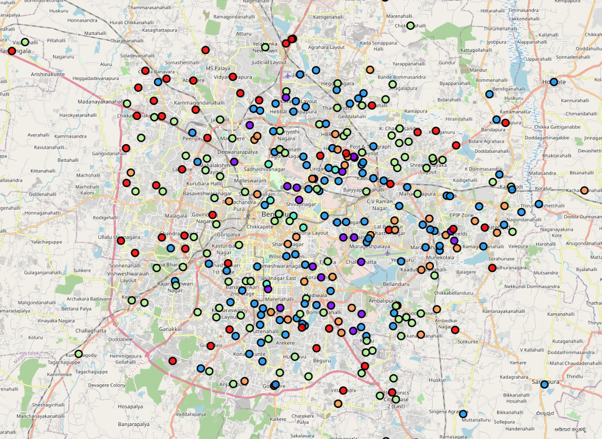





Bengaluru neighbourhood clusters
More number of amenities, higher the average rental rate
Cheaper neighbourhoods with fewer amenities located on the outside
More desirable neighbourhoods towards interior Bengaluru
Posh, affluent outliers in the dataset grouped in the heart of the city
Clusters 2 & 5 – similar in amenities with the former Rs. 6000 cheaper on average, grouped in NE Bengaluru, can yield good RoI

Slide 7
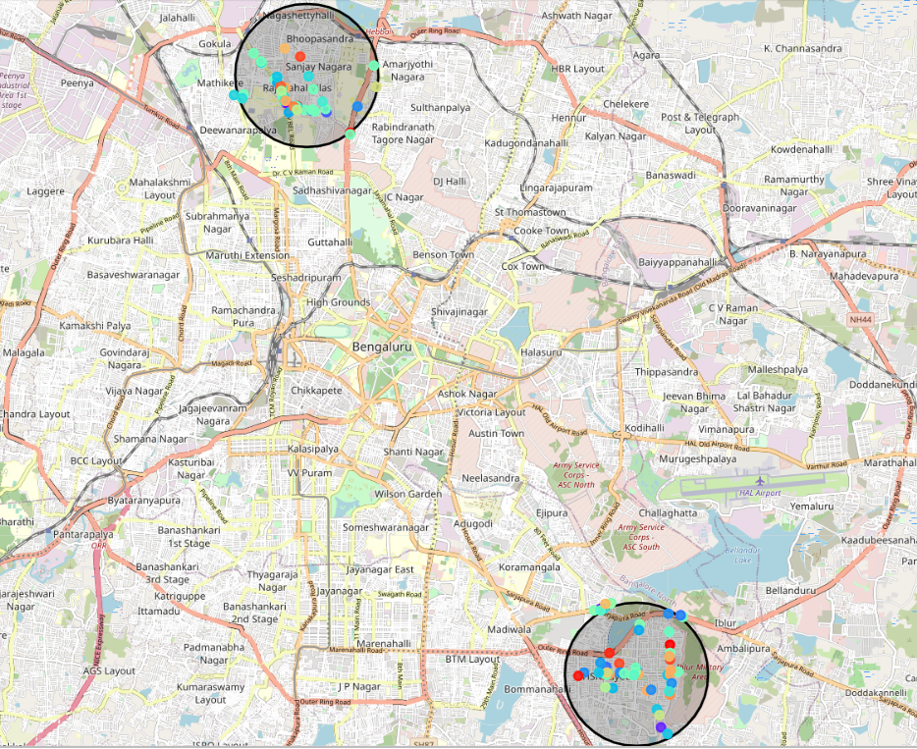
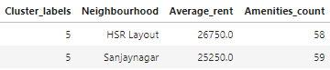
Neighbourhood like HSR Layout
Sanjaynagar in North Bengaluru is a neighbourhood that is similar to HSR Layout in the south
The average rental rates of the neighbourhoods are comparable as are the number of amenities

